Slide 1
OBI Tutorial Overview
http://kr-med.org/icbofois2012/obi/index.htm
8:30 AM Introduction To OBI
Presenter: Christian Stoeckert
Content: Overview of OBI including details of OBI core
Hands-on Exercises: Accessing and browsing OBI and associated resources.
9:30 AM BioBreak
9:45 AM Representation Of Biomedical Investigations Using OBI
Presenter: Jie Zheng
Content: The ontology-base modeling of investigation will aid understanding of each step of an experiment. This modeling also provides a map of biomedical data to Resource Description Framework (RDF) triples which in turn facilitates data integration and enables SPARQL queries. A biomedical investigation about host and parasite interactions will be used as an example. This part will also cover the relationship between OBI and the Evidence Code Ontology (ECO).
Hands-on Exercises: Generate a community view of OBI for a specific application using Ontodog.
11:00 AM Coffee/ Tea break
11:15 AM Ontology Development By Using OBI As A Source Ontology
Presenter: Yongqun "Oliver" He
Content: Development of the Vaccine Ontology (VO) will be used to show how to develop an application ontology that is based on OBI. It will cover two strategies, MIREOT (importing external ontology terms) and QTT (adding multiple terms in an ontology), which were developed by OBI developers to facilitate ontology development.
Hands-on Exercises: Reuse OBI terms in VO based on MIREOT using OntoFox and add a set of new terms based on QTT using Ontorat.

Slide 2
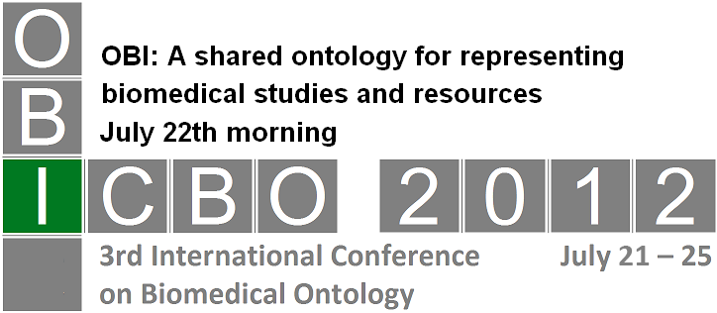

Ontology for Biomedical Investigations (OBI) - Overview
Chris Stoeckert
University of Pennsylvannia

Slide 3
What will be covered
OBI scope and purpose
High level overview
OBI structure
Guiding principles for development
Core terms
Purpose and content
Basic investigation
Resources for making use of OBI
Interacting with OBI developers

Slide 4
Ontology for Biomedical Investigations
OBI is about capturing all aspects of an investigation (study, experiment, etc.)
OBI is part of a group that follows the same principles and uses the same structure.
The group is called the OBO Foundry and includes the Gene Ontology (GO)
OBI is a candidate under review
OBI provides a means to integrate people, places, specimens, protocols, data all through the context of performing an experiment.
J Biomed Semantics. 2010. Modeling biomedical experimental processes with OBI, Ryan R Brinkman, Mélanie Courtot, Dirk Derom, Jennifer M Fostel, Yongqun He, Phillip Lord, James Malone, Helen Parkinson, Bjoern Peters, Philippe Rocca-Serra, Alan Ruttenberg, Susanna-Assunta Sansone, Larisa N Soldatova, Christian J Stoeckert, Jr., Jessica A Turner, Jie Zheng, and the OBI consortium
OBI scope and purpose

Slide 5
Ontology
A set of concepts within a domain and the relationships between those concepts
Unambiguous description of a domain
Controlled vocabulary
Relations (logical constraints among terms)
Human readable and machine interpretable
Uses
Annotation
Text mining
Semantic web
Reasoning
OBI scope and purpose
Notes:
controlled vocabulary with additional logical constraints
describe all entities within an area of reality and all relationships between those entities.
An ontology comprises a set of well-defined terms with well-defined relationships.
The structure itself reflects the current representation of biological knowledge as well as serving as a guide for organizing new data.
Data can be annotated to varying levels depending on the amount and completeness of available information.
Machine interpretable
Will enhance data (re-)usable
Relations – logical rules among concepts

Slide 6
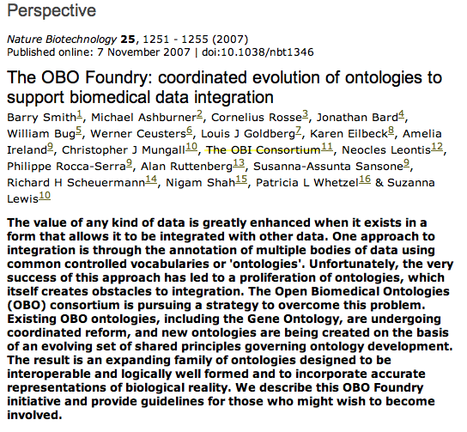
OBO Foundry
OBI scope and purpose

Slide 7
OBI – a user driven project
~20 communities that recognized they were trying to solve the same / related problems
OBI developers typically have one or more applications that drive OBI development
6 year effort, 1-2 phone calls per week, 1-2 meetings per year
first stable release (Philly RC1) in Oct. 2009
→ Open project with constant addition of new communities, please consider joining!
OBI scope and purpose

Slide 8
OBI Timeline
MO/ MAGE
FuGO
FuGE
OBI
2004 2005 2006 2007
MAGE
Jamboree
Hinxton
Dec
1st FuGO
Workshop
Philadelphia
Feb.
2nd FuGO
Workshop
Hinxton
July
OBI Workshop San Diego Jan.
SOFG
Philadelphia
Oct
MAGE
Jamboree
Stanford
March
MGED 8
Bergen
Sept.
Transcriptomics (MGED)
Proteomics (PSI)
PSI
Siena
April
Cancer Genomics
Polypmorphisms
Genome Sequences
Crop Sciences
Toxicogenomics
Environmental Genomics
Nutrigenomics
(MGED RSBI)
Metabolomics
Flow Cytometry
Cellular Assays Immport IEDB Neuroinformatics
From Jan, 2007 OBI workshop in LIAI
OBI scope and purpose

Slide 9
OBI Timeline
Vancouver 2010
4/11 7/11 12/11
Philly 2009
San Diego 2011
3/12 7/12
2007 2008 2009 2010 2011 2012
Workshops:
Bethesda Vancouver EBI EBI Philly Vancouver San Diego Philly
Ann Arbor
DENRIE -> IAO
OBO Foundry
J Biomed Sem.
MIREOT
Bio-imaging,
Clinical Investigations,
Electrophysiology,
Structural Biology
Robot
Scientists
ECO
Vaccines
Eagle-i
OBI scope and purpose

Slide 10
User metrics
Google scholar: OBI “ontology for biomedical investigations” > 200 journal articles
NCBO Bioportal: 21 communities use obi.owl
OBI scope and purpose

Slide 11
Examples of using OBI
JZ, CS –FGED view, Ontology for Parasite Life Cycle, Biobank LIMS, NIAID Core Metadata,
OH – Vaccine Ontology
Bjoern Peters – Immune Epitope Database
Philippe Roca-Serra – ISA
Marcus Chiboucos – Evidence Code Ontology
Carlo Toniai, Melissa Haendel, Matthew Brush – eagle-i, Reagent Ontology
Others ….
OBI scope and purpose

Slide 12
OBI –high level overview
processed material
data item
cell culture
organization
document
PCR product
Information content entity
Chemical solution
plan specification
molecular entity (ChEBI)
dependent variable specification
material entity (BFO)
protein complex (Gene Ontology)
investigation
cell (Cell Ontology)
planned process
study design execution
gross anatomical part (CARO)
manufacturing
assay
organism (NCBI taxonomy)
material processing
material combination
High level overview

Slide 13
OBI uses BFO and IAO
The Basic Formal Ontology (BFO) is used as the upper level ontology.
Reality based.
OBI is using a prerelease v2
OBO format ID. simplified version of BFO v1.
includes some relations. Import part of Relations Ontology used by OBI
See BFO2 tutorial
The Information Artifact Ontology (IAO) is used for general information content entities
Originated as a branch of OBI and overlap in developers
High level overview

Slide 14
material entity
merged bfo:object, object part, object aggregate (what is a cell inside my body?)
Import natural biomaterials (MIREOT mechanism), e.g. organism (NCBI taxonomy), ‘gross anatomical part’ (CARO), ‘molecular entity’ (ChEBI)
OBI’s primary scope
‘processed material’
‘material entity’
specified_output_of some 'material processing’
Some natural biomaterials can also be created (e.g. molecules) → no asserted disjoint
specimen, study subject
material entities about which information is gathered during an investigation
may or may not be processed materials
processed material
organization
Chemical solution
molecular entity (ChEBI)
material entity (BFO)
protein complex (Gene Ontology)
cell (Cell Ontology)
gross anatomical part (CARO)
organism (NCBI taxonomy)
High level overview

Slide 15
planned process
realizes a ‘plan specification’ which includes an ‘objective specification’ (describing the desired endpoint)
has specified inputs and outputs (=participants called out in the specification)
high level classes:
‘material processing’ (input: material, output: material)
assay (input: material, output: data item)
‘data transformation’ (input:data item output:data item)
investigation
planned process
study design execution
assay
material processing
High level overview

Slide 16
information content entity
Defined in IAO, a separate effort spawned from OBI, that is still tightly interlinked
every ‘information content entity’ is_about something
Examples: ‘plan specification’, ‘journal article’, ‘data item’
OBI subclasses these, e.g.: ‘study design’, ‘dependent variable specification’, ‘measurement datum’
data item
document
Information content entity
plan specification
dependent variable specification
High level overview

Slide 17
roles and qualities
Specifically dependent continuants from BFO
quality
Subclasses imported from PATO
length, ‘biological sex’, ‘biomaterial purity’
roles
Realized in some process
‘specimen role’, ‘analyte role’
High level overview

Slide 18
Main Components of OBI and Their Relations
role
is_a dependent_
continuant
has role
has specified input
material entity
is_a independent
_continuant
planned
process
is_a occurrent
has specified output
has specified input
has quality
is about
has specified output
information content entity (ICE)
quality
is_a dependent_
continuant
is about
High level overview
Notes:
Central: process
What’s its inputs/outputs
Material entity, collect specimen, blood, blood specimen
Material entity, ICE, assay, blood specimen, glucose concentration in the blood
ICE, ICE, data transformation, glucose concentration in one person, average glucose concentration in a week
Material entity
- Role: patient role, study subject role, reference role
Quality: weight, height
ICE of quality: weight – 50 kg, height 1.6 meter
ICE of material entity: person name, specimen identifier

Slide 19
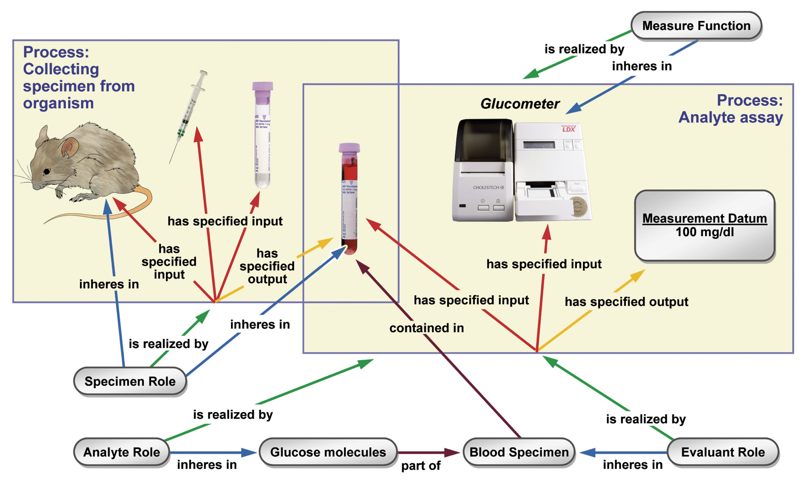
Measuring the glucose concentration in blood
High level overview

Slide 20
2011 OBO Foundry Principles – 2009 review
FP01 open: Yes
FP02 format: OWL now providing an obo version
FP03 identifiers: names and identifiers are unique
FP04 versioning: dc:date, owl:versioninfo. 8 stable releases since 2009
FP05 delineated content : clearly delineated.
FP06 textual definitions : completeness is high. (Now required for release)
FP07 relations: RO /ro_proposed used where appropriate.
FP08 documentation: 1 Paper on OBI + 3 on design principles. Wiki manuals
FP09 users: TBD. but see projects using OBI on NCBO Bioportal
FP10 collaboration: YES (gold star)
FP11 locus of authority: Yes
FP12 naming conventions: being followed during development
FP16 maintenance: constant updates (e.g. sequencing techniques)
High level overview

Slide 21
OBI Core
OBI Core is a collection of key terms from OBI and related ontologies. It serves two related purposes:
For OBI users the core provides a starting point for understanding the most important high-level terms and their relations.
For ontology developers the core provides the fundamental organization of OBI, and a structure into which more specific terms can be fitted.
Core terms

Slide 22
OBI Core
OBI Core consists of two parts:
The "inner core" of 28 terms that belong to OBI and IAO.
The "outer core" of 13 terms that belong to other ontologies.
When these 40 terms are taken together and reasoned over using OWL, the result is a set of approximately 100 terms. We call this the "complete core".
Core terms

Slide 23
OBI Core
OBI Core serves educational and organizational goals. We have selected the core terms because they are:
important for modeling a large majority of biomedical investigations with OBI
are ready for widespread use
While meeting these two criteria, we also aim to keep the complete core fairly small.
Core terms

Slide 24
OBI Inner Core
acquisition
assay
centrally registered identifier (CRID) registry
centrally registered identifier (CRID) symbol
conclusion textual entity
data item
data transformation
dependent variable specification
device
document
documenting
human subject enrollment
hypothesis textual entity
independent variable specification
information content entity
investigation
investigation agent role
measure function
measurement datum
plan
planning
population
protocol
specimen
specimen collection
study design
study design execution
study subject role
Core terms

Slide 25
OBI Outer Core
biological_process from the Gene Ontology (GO)
cellular_component from the Gene Ontology (GO)
molecular_function from the Gene Ontology (GO)
cell from the Cell Ontology (CL)
environmental material from the Environment Ontology (EnVO)
geographical location from Gazetteer (GAZ)
gross anatomical part from the Common Anatomy Reference Ontology (CARO)
Homo sapiens from the National Center for Biotechnology Information Taxonomy (NCBITaxon)
measurement unit label, included to connect to the Ontology of Units of Measurement (UO)
molecular entity from Chemical Entities of Biological Interest (ChEBI)
organism, included to connect to the National Center for Biotechnology Information Taxonomy (NCBITaxon)
quality, included to connect to the Phenotypic Quality Ontology (PATO)
disease course from the Ontology for General Medical Science (OGMS)
Core terms

Slide 26
General Model of a Biomedical Investigation
At the heart of the Ontology for Biomedical Investigations is our model of an investigation.
An investigation is a process with three parts:
the planning stage, in which a study design is created.
the study design execution stage, in which the steps of the study design are carried out.
the investigation reporting stage, in which an investigation report is created.
The output of an investigation is the investigation report, which includes a statement of the conclusions of the investigation.
Core terms

Slide 27
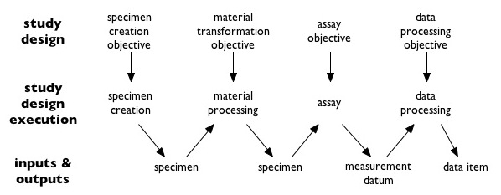
Investigation
Core terms

Slide 28
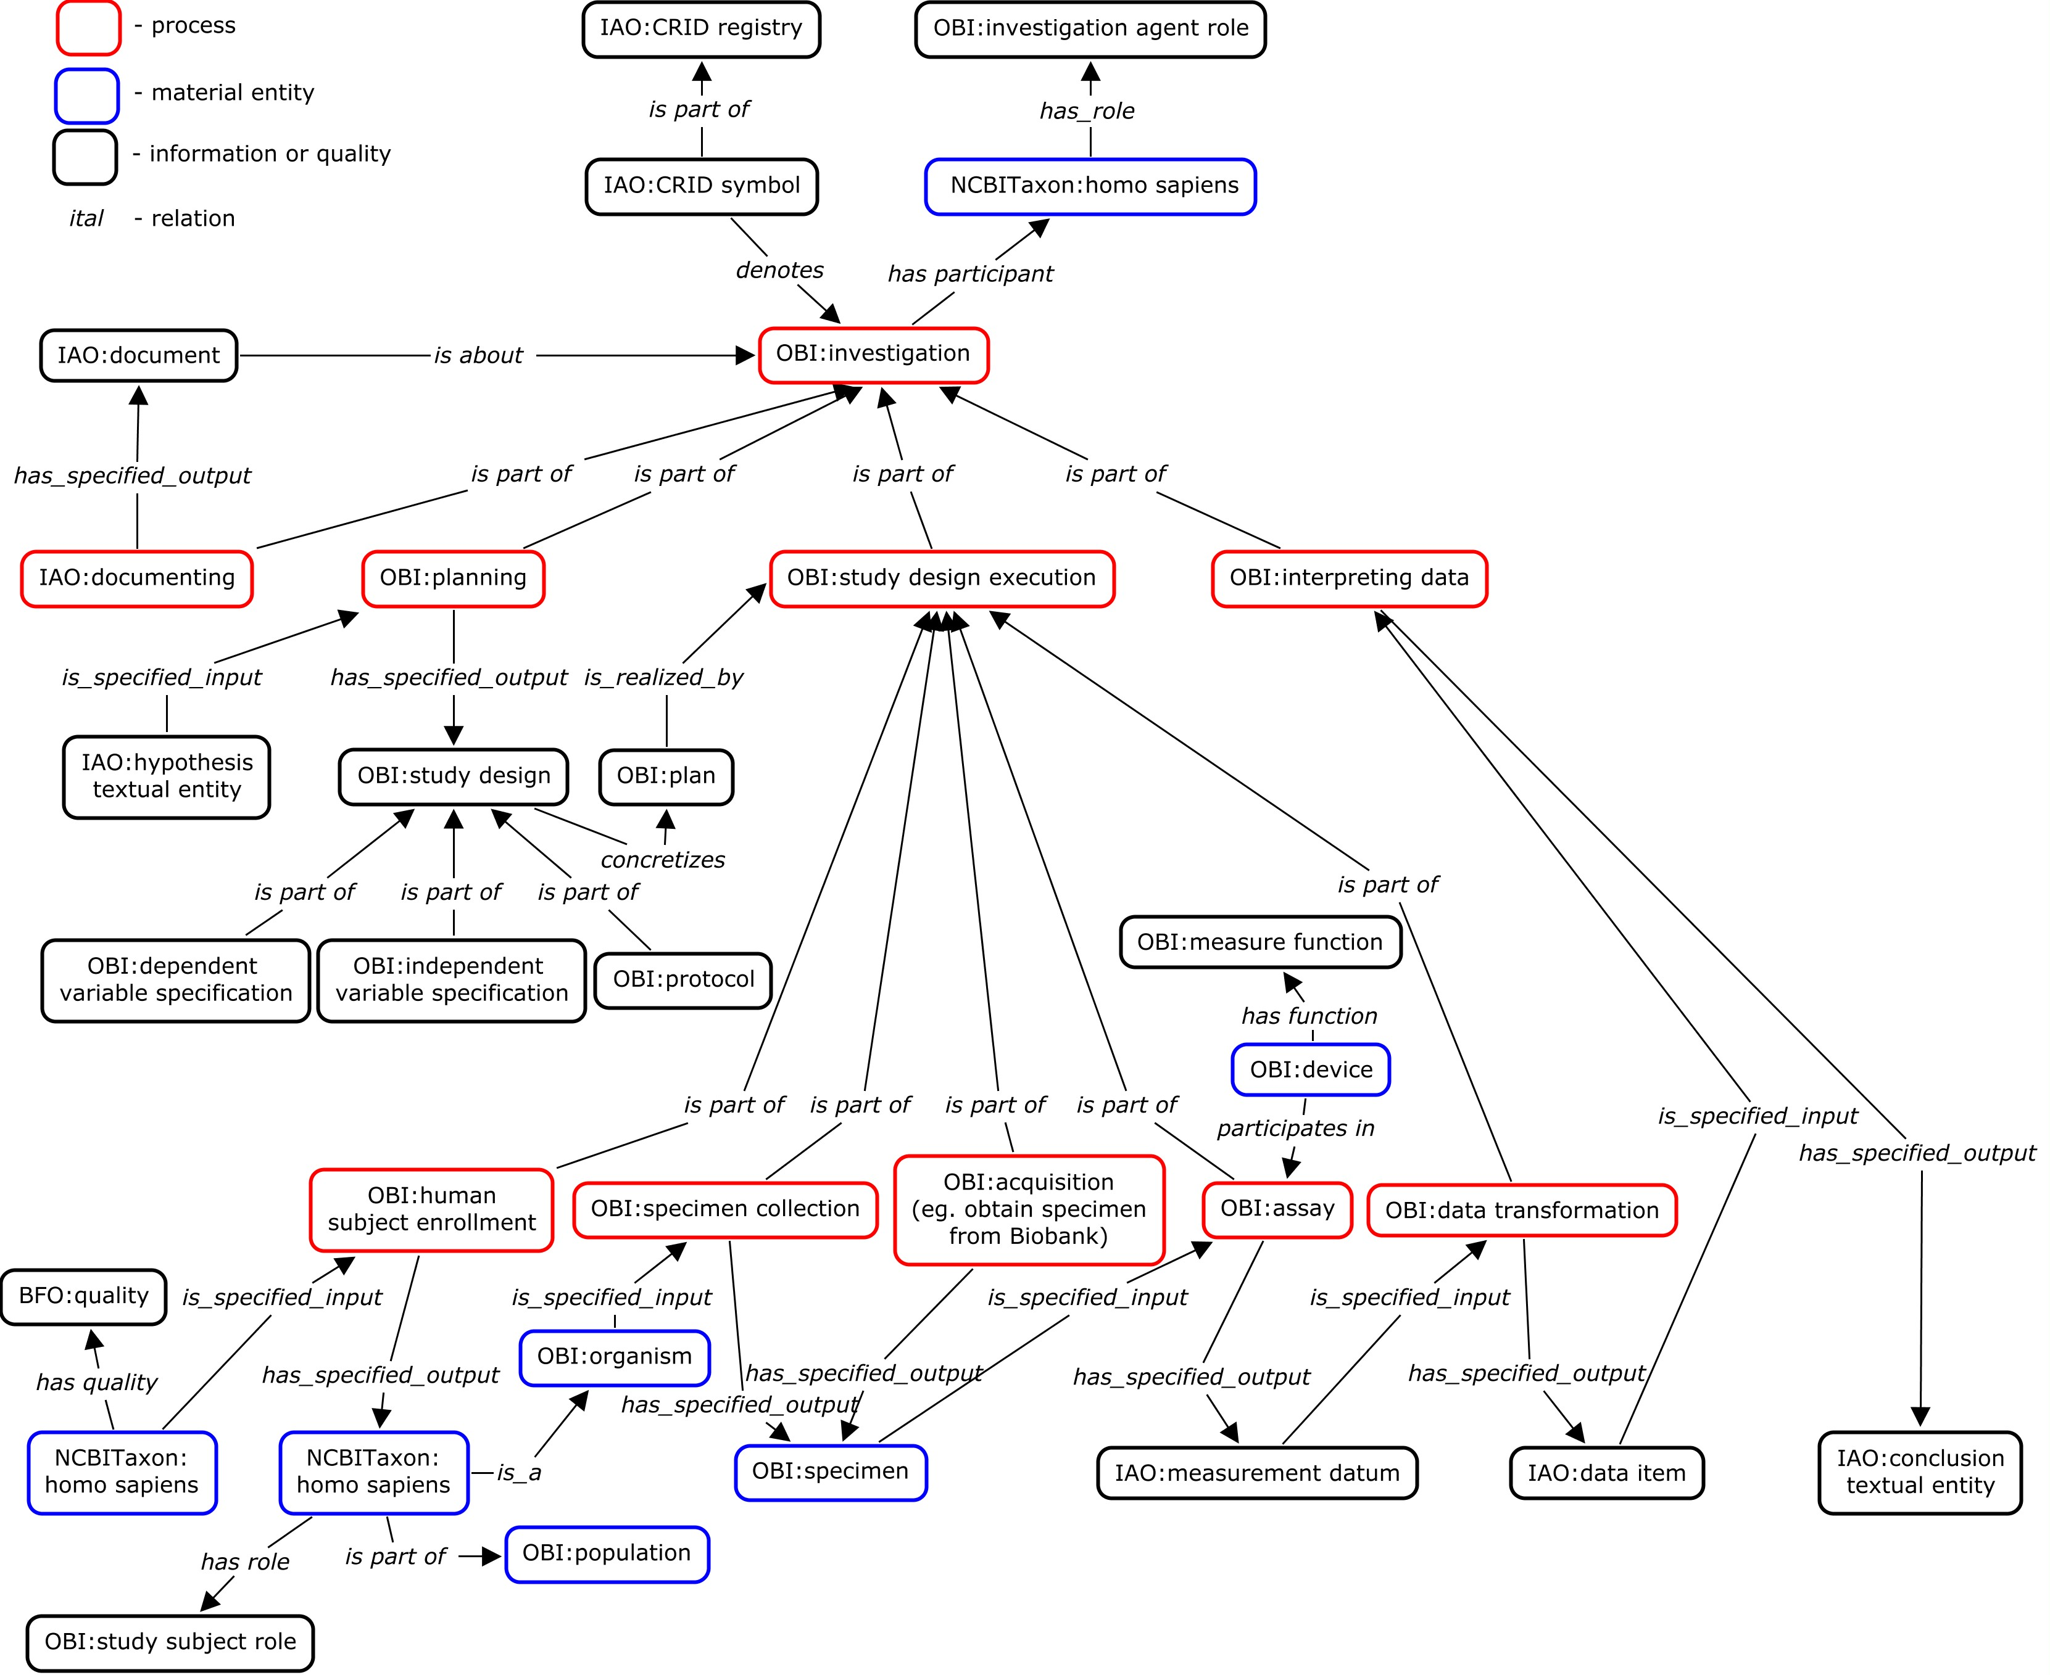
Core terms

Slide 29
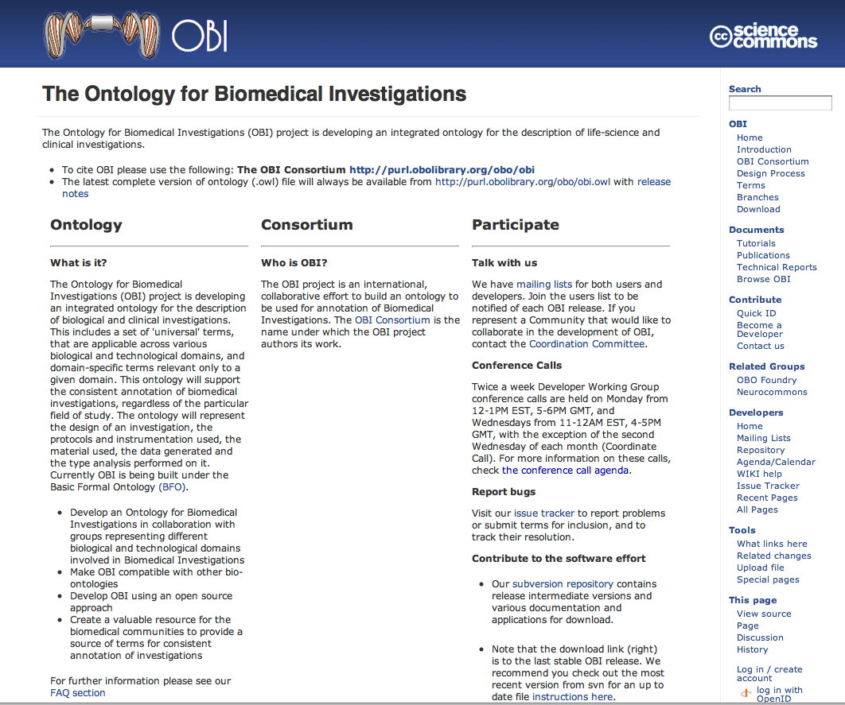
OBI Web Site: obi-ontology.org
Resources for making use of OBI

Slide 30
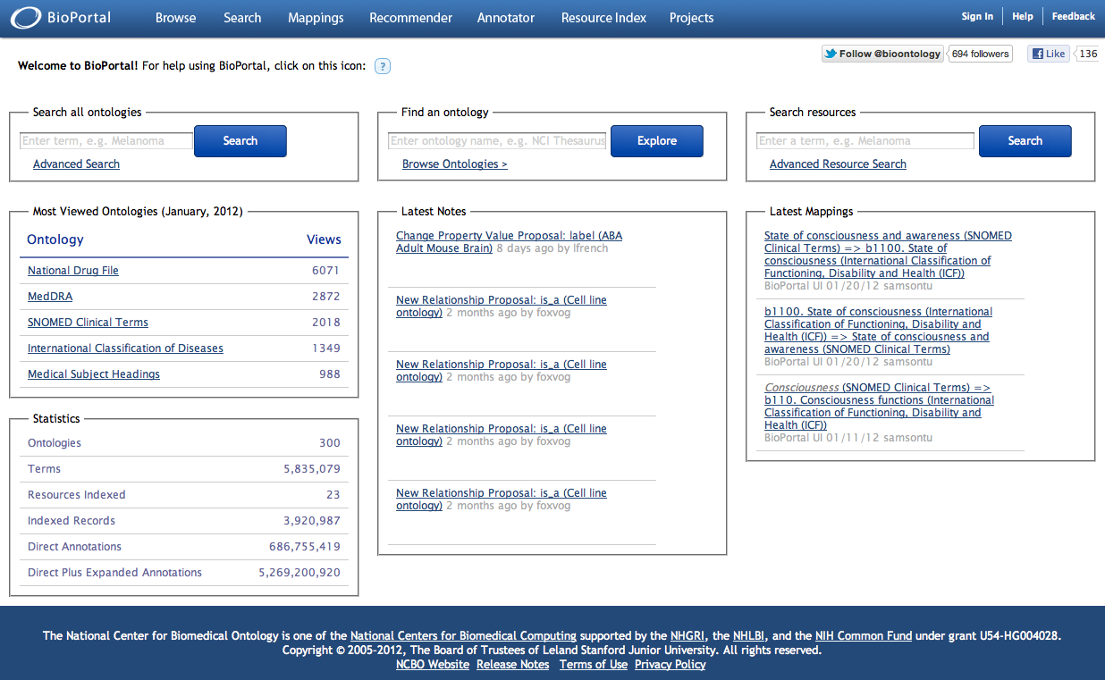
OBI is available at the NCBO Bioportal http://bioportal.bioontology.org/
Resources for making use of OBI

Slide 31
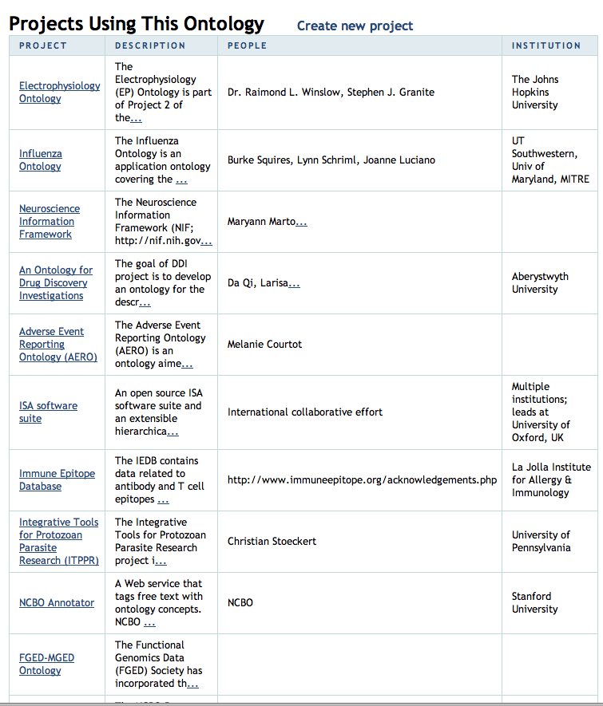
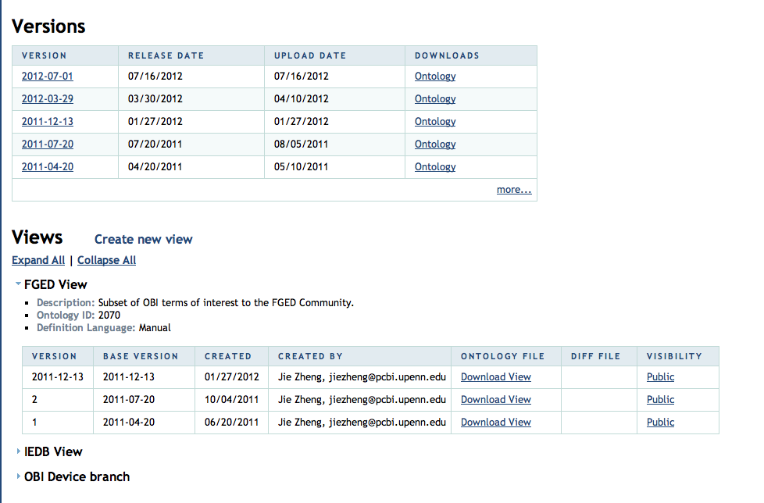
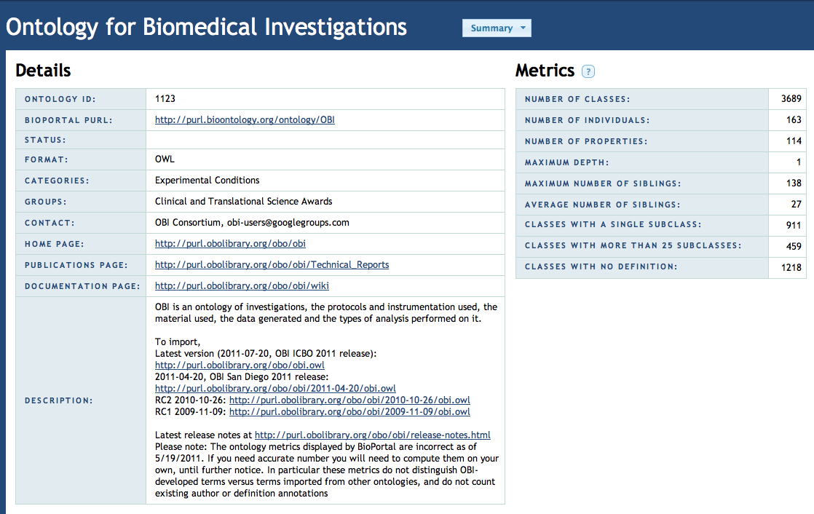
Resources for making use of OBI

Slide 32
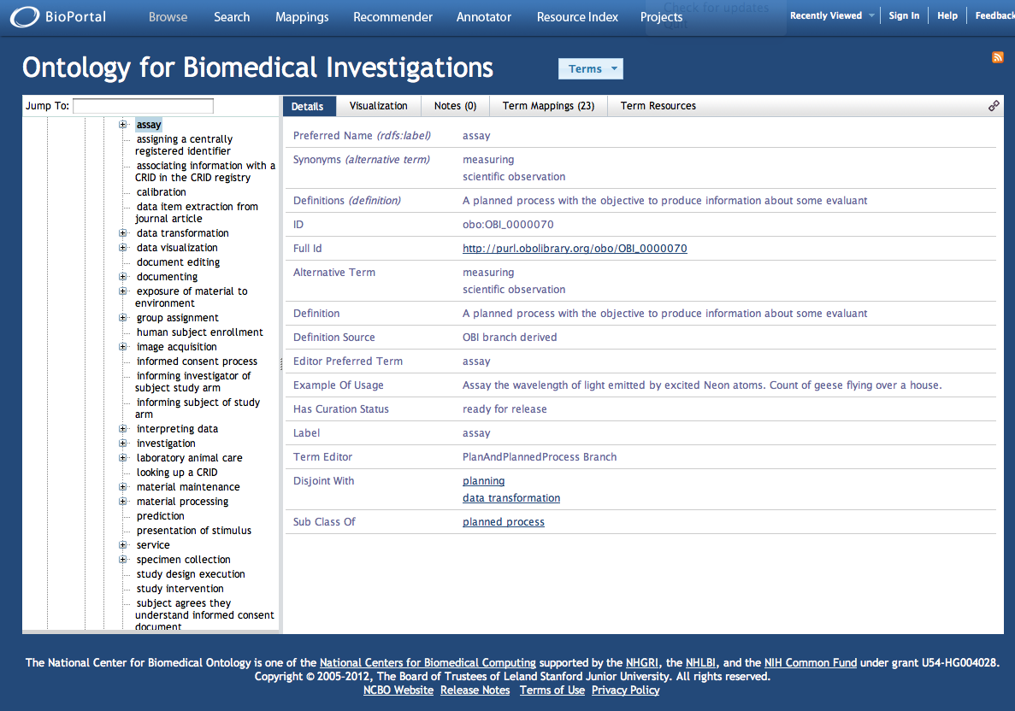
Resources for making use of OBI

Slide 33
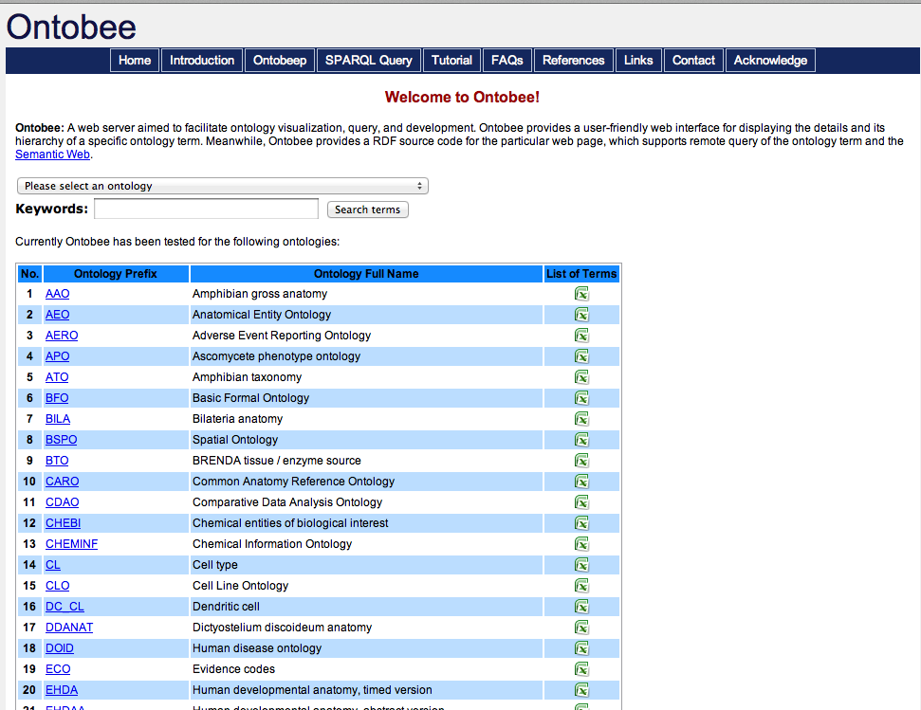
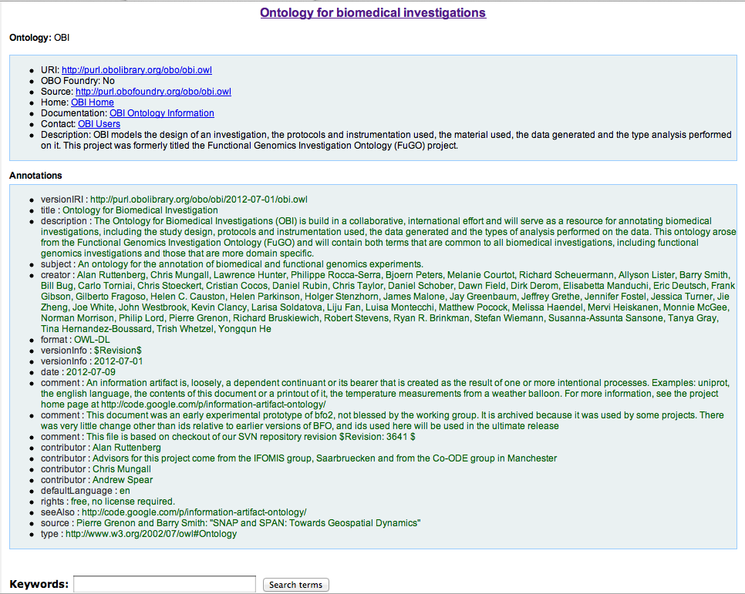
OBI is also available at Ontobee http:www.ontobee.org
Resources for making use of OBI

Slide 34
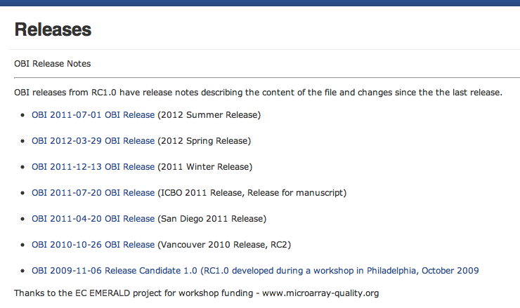
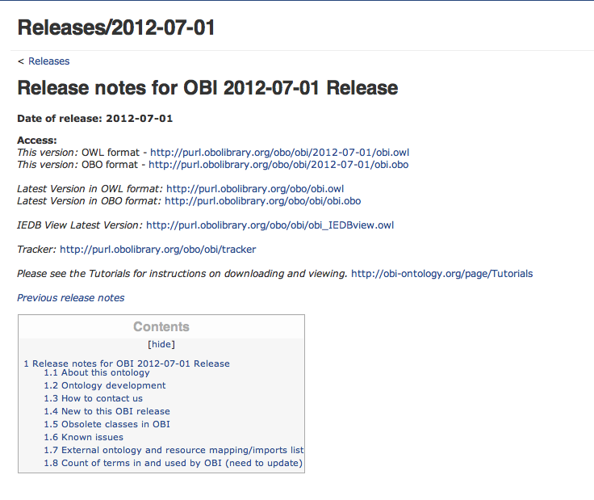
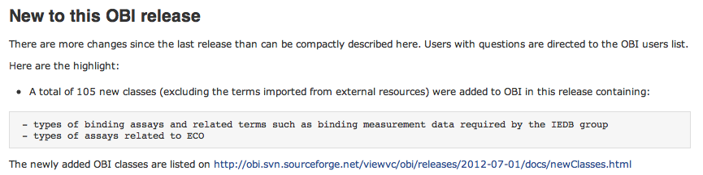
OBI Releases http://obi-ontology.org/page/Releases
Resources for making use of OBI

Slide 35
The development version of OBI is available through the svn code repository
Follow OBI Ontology Check Out at OBI tutorial page: http://kr-med.org/icbofois2012/obi/index.htm
Command to check out latest version of OBI:
svn co http://obi.svn.sourceforge.net/svnroot/obi/trunk/src/ontology/
Download CORE version of OBI:
https://obi.svn.sourceforge.net/svnroot/obi/trunk/docs/presentations/OBI%20tutorial%20July%202012%20ICBO/Ontodog/Output%20files/
Details for SVN see: http://obi-ontology.org/page/General_introduction#SVN
Browse OBI with Protégé (Instructions also at the OBI tutorial page)
Download Protege 4.2 release at: http://protege.stanford.edu/download/protege/4.1/installanywhere/Web_Installers/
Follow the instruction to install Protege posted on the page: http://protegewiki.stanford.edu/wiki/Protege-OWL_4_FAQ#How_do_I_install_Protege-OWL.3F
Load the checked out version of OBI from the file: branches/obi.owl or load from the url: http://purl.obolibrary.org/obo/obi.owl
Run the reasoner (Hermit recommended) to see inferred hierarchy.
Resources for making use of OBI

Slide 36
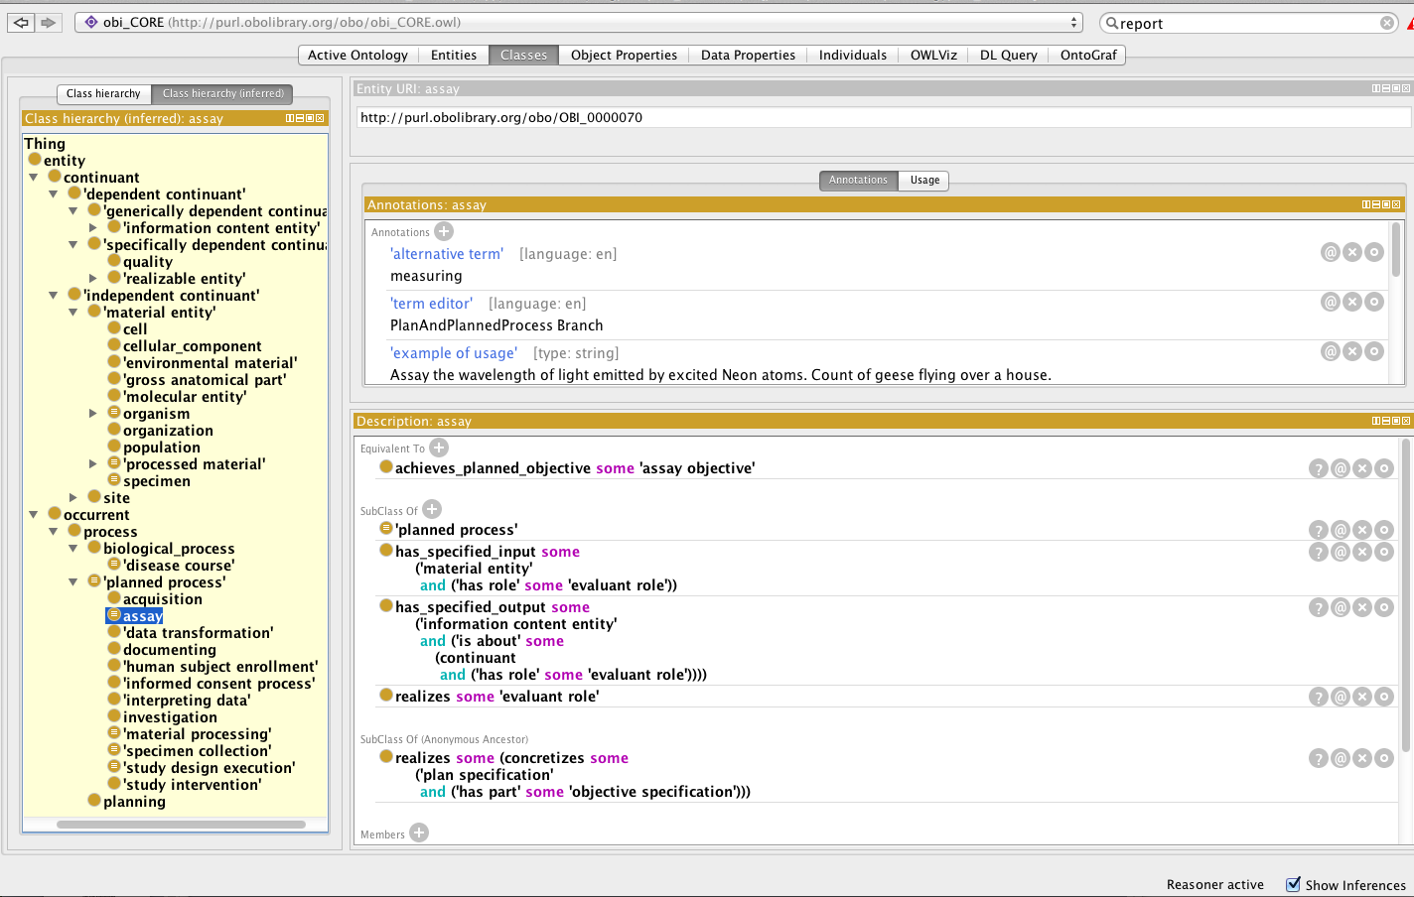
OBI Core in Protégé 4.2
Resources for making use of OBI

Slide 37
Contributing to OBI
Submit new terms to OBI via tracker:
http://sourceforge.net/tracker/?group_id=177891&atid=886178
Join OBI mailing list:
obi-developer: List for discussion regarding the development of OBI. email obi-developer
obi-users: List for general discussion on using OBI. email obi-users
Interacting with OBI developers

Slide 38
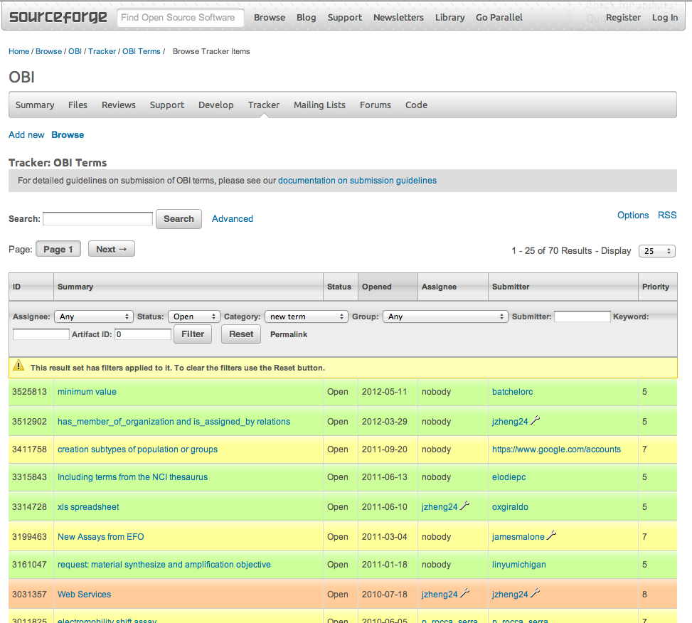
OBI Tracker
Interacting with OBI developers

Slide 39
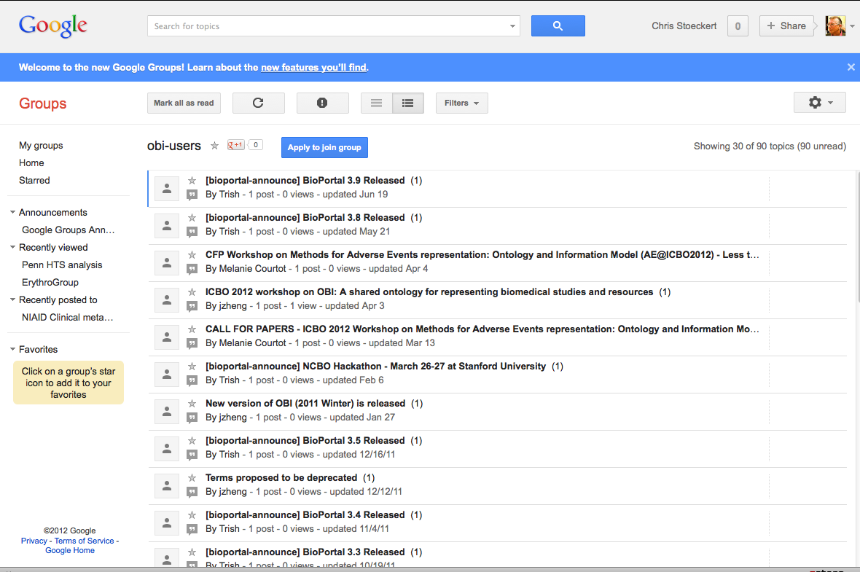
Archive of OBI Users list
Interacting with OBI developers

Slide 40
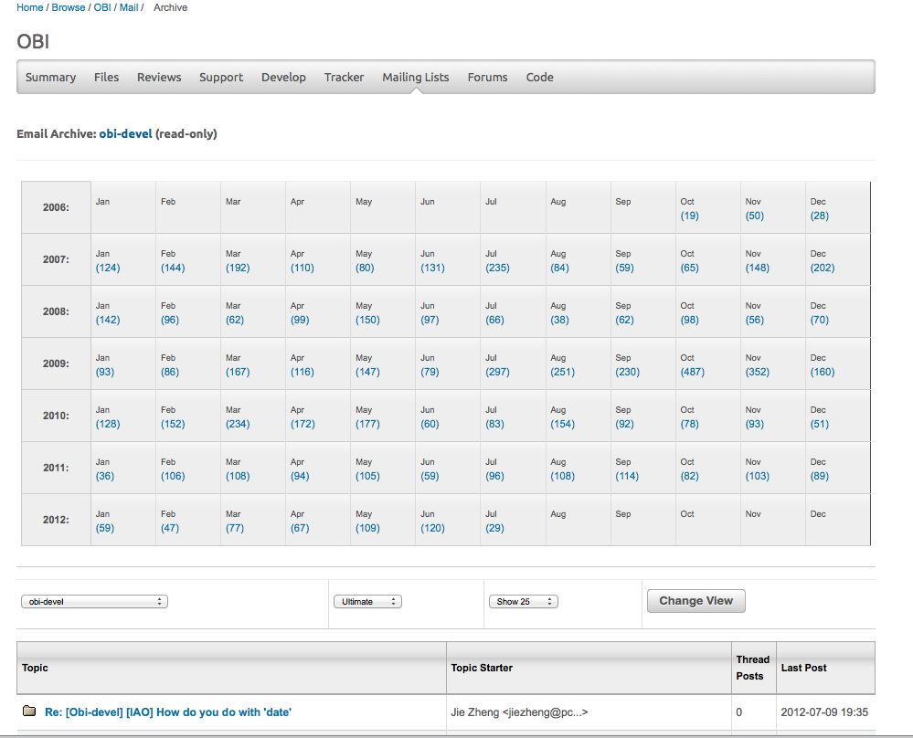
Archive of OBI dev list
Interacting with OBI developers

Slide 41
Summary
OBI is a multi-community project driven by the practical needs of its members with the goal to build a high quality, interoperable reference ontology
OBI high level classes are in place - solidified over several years - that cover all aspects of biomedical investigations
OBI is expanded to enable member applications and based on term requests

Slide 42
Acknowledgements
Jie Zheng – for putting the tutorial together, much of the material, and generating the Core file
Oliver(Yongqun) He – for putting the tutorial together
James Overton – for Core & Investigation material
Bjoern Peters – for slides adapted from ICBO 2011
Carlo Tornia – for getting the latest release out with Jie
The OBI consortium

